Slide 1
Reading And Writing Data To Databases

Slide 2
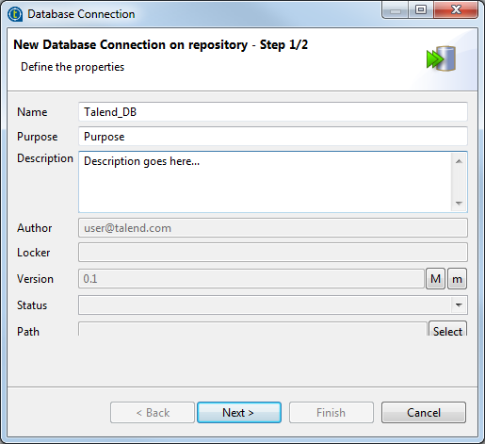
Create a Connection
Expand Metadata in the Repository tree view, right-click Db Connections and select Create connection

Slide 3
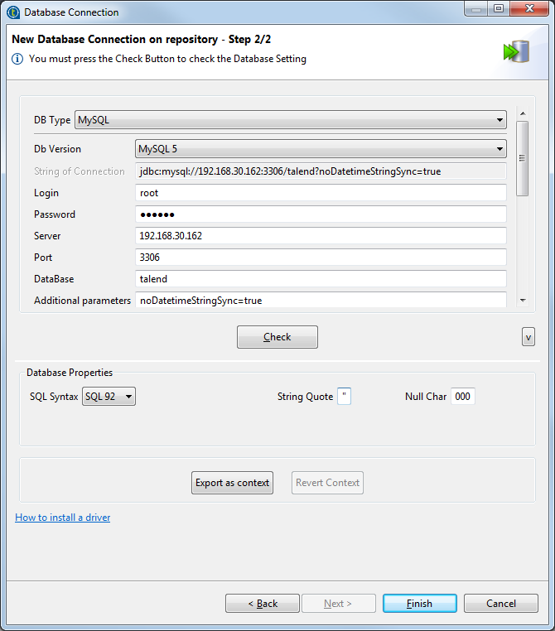

Slide 4
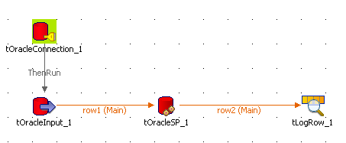

Slide 5
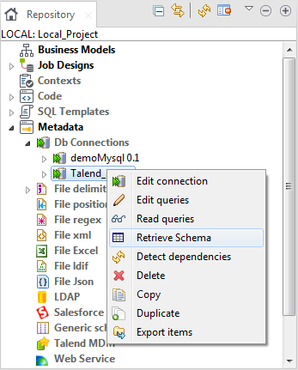
List All Column in a Oracle table

Slide 6
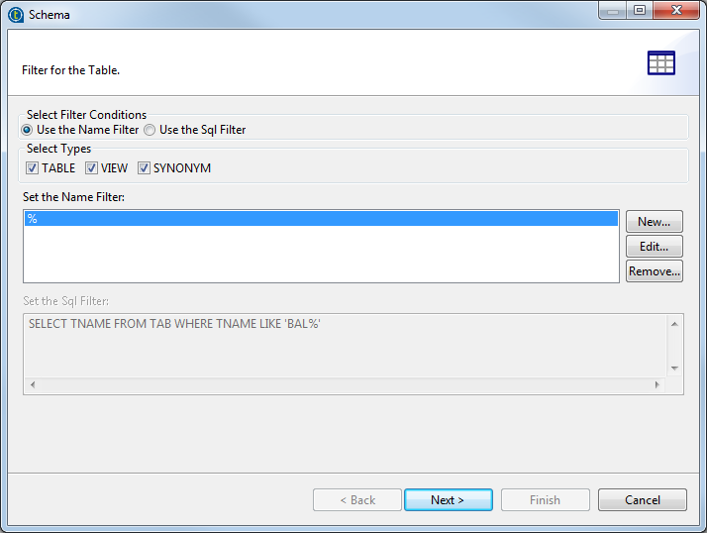

Slide 7
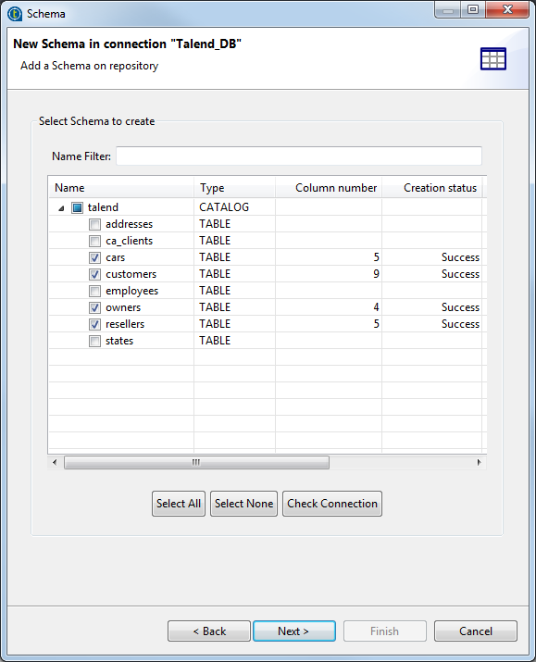

Slide 8
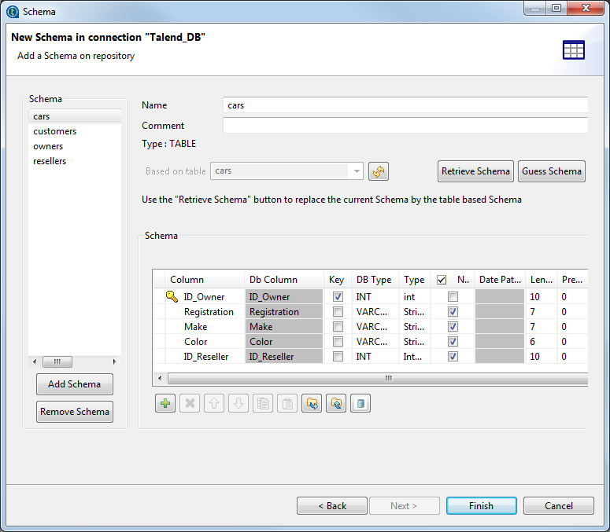

Slide 9
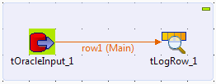
Extract Fields based on a Query from Oracle

Slide 10
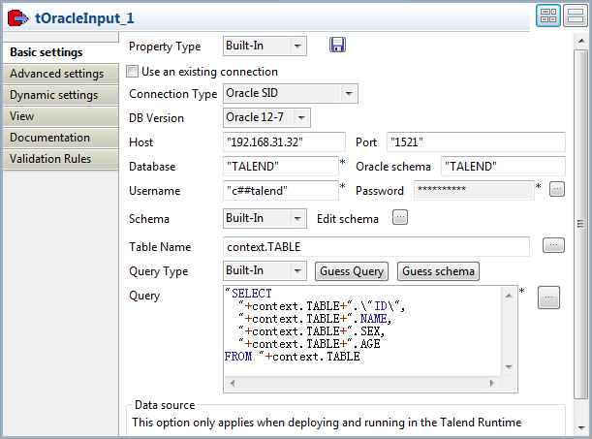

Slide 11
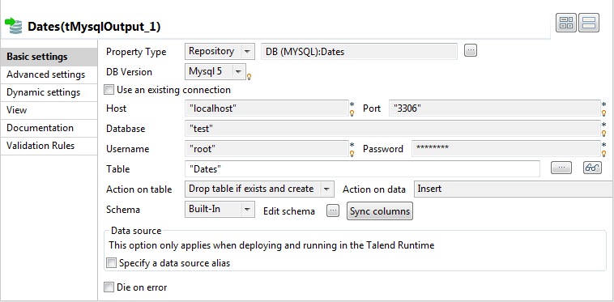
Insert, Update Make changes in Database

Slide 12
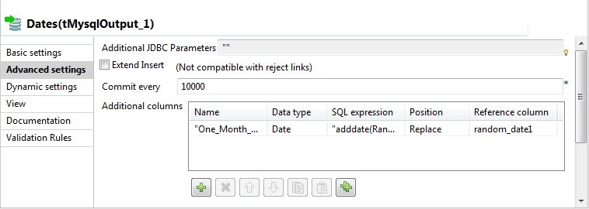

Slide 13
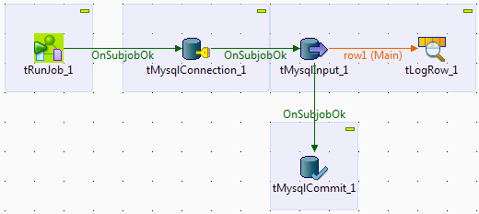
Commit data in database

Slide 14
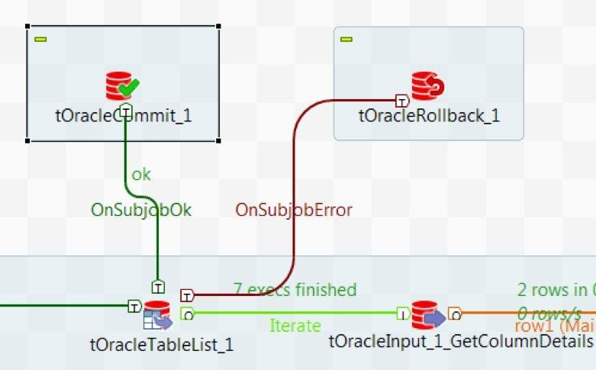
Rollback a Transaction in talend

Slide 15
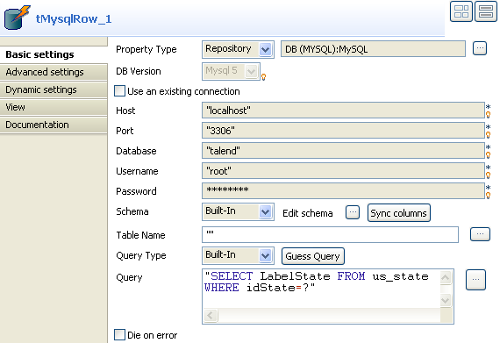
tOracleRow/tMySqlRow in Talend

Slide 16
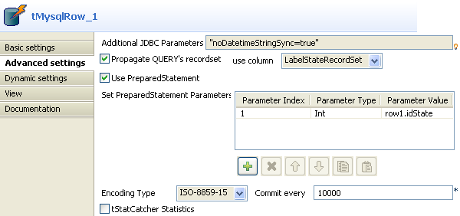

Slide 17
Questions?
Copyright © 2014 by Vikram Takkar. All Rights Reserved..

